Slide 1

Modeling Inference and Averaging
Bootstrap / ML / Bayesian
19.02.15 임소현

Slide 2
The Bootstrap
and
Maximum Likelihood Methods
1
2
Bayesian Methods
Relationship Between
The Bootstrap
And
Bayesian Inference
3

Slide 3
01
The Bootstrap
and
Maximum Likelihood Methods

Slide 4
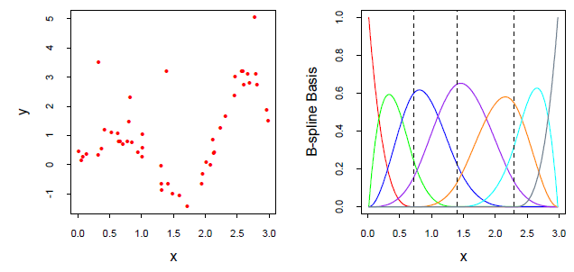

1.1 / A Smoothing Example
N = 50 data points shown in the left panel
A cubic spline to the data, with three knots placed at the quartiles of the X values
a linear expansion of B-spline basis functions
hj(x), j = 1, 2, . . . , 7 are the seven functions shown in the right panel

Slide 5




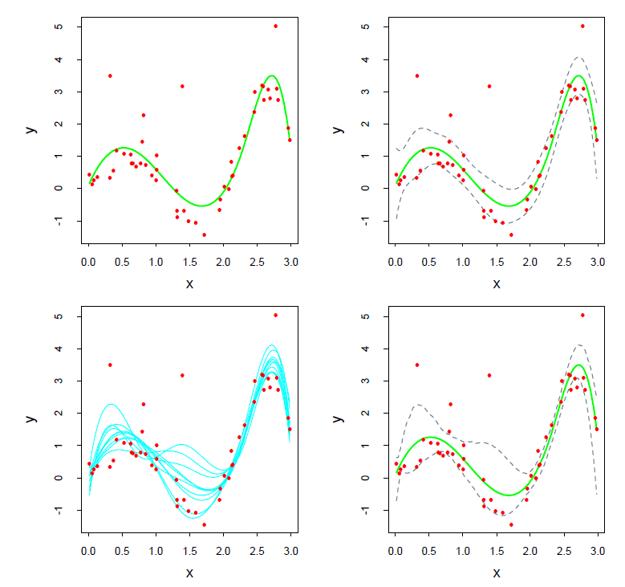
1.1 / A Smoothing Example
Let H be the N ×7 matrix with ijth element hj(xi)
Estimate of β, obtained by minimizing the squared error
The estimated covariance matrix
kk

Slide 6
1.1 / A Smoothing Example
draw B=200 datasets each of size N=50 with replacement from our training data
to each bootstrap dataset Z∗ , fit a cubic spline ˆμ∗(x)
the fits from ten such samples are shown in the bottom left panel

Slide 7
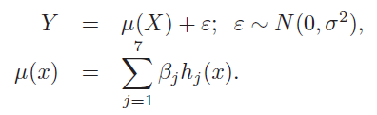


1.1 / A Smoothing Example
assume that the model errors are Gaussian,
sample with replacement from the training data, is called the nonparametric bootstrap
consider a variation of the bootstrap, called the parametric bootstrap
simulate new responses by adding Gaussian noise to the predicted values -> repeated B times
A function estimated from a bootstrap sample y∗ is given by ˆμ∗(x) = h(x)T (HTH)−1HT
-> the mean of this distribution is the least squares estimate

Slide 8








1.2 / Maximum Likelihood Inference
, θ : one or more unknown parameters of Z, called a parametric model for Z
if Z has a normal distribution
Maximum likelihood is based on the likelihood function,
log-likelihood
maximum likelihood chooses the value θ = $\hat{\text{θ}}$ to maximize
Notes:
Score function, information matrix, fisher information, maximum likelihood estimate

Slide 9



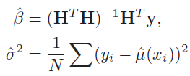


1.2 / Maximum Likelihood Inference
Let
the log-likelihood is
By setting and ,
The information matrix
agrees with the least squares estimate

Slide 10
02
Bayesian Methods

Slide 11


02/ Bayesian Methods
we specify a sampling model Pr(Z|θ), and a prior distribution for the parameters Pr(θ)
compute the posterior distribution,
The posterior distribution also provides the basis for predicting the values of a future observation,
via the predictive distribution
unlike the predictive distribution, this does not account for the uncertainty in estimating θ

Slide 12

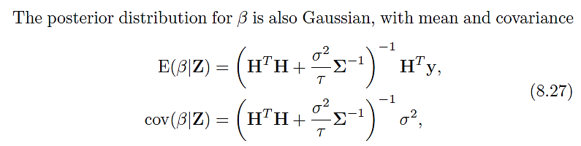
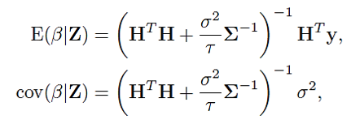

02/ Bayesian Methods
The parametric model and $σ^{2}$ is known
a prior for the coefficients β, and this defines a prior for μ(x).
a
Notes:
We choose a Gaussian prior centered at zero
with the choices of the prior correlation matrix § and variance τ to

Slide 13
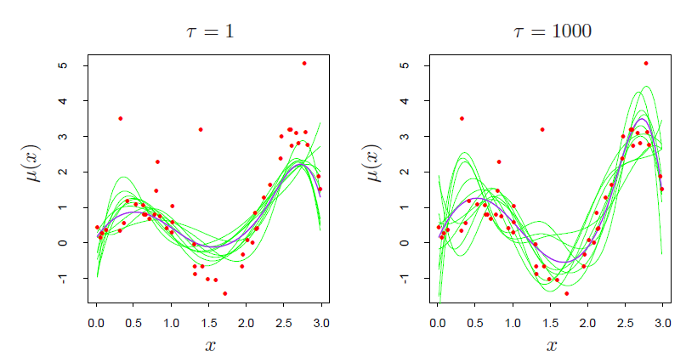
02/ Bayesian Methods
as τ → ∞, the posterior distribution and the bootstrap distribution coincide
τ = 1, the posterior curves μ(x) are smoother than the bootstrap curves,
because we have imposed more prior weight on smoothness.
Notes:
We choose a Gaussian prior centered at zero
with the choices of the prior correlation matrix § and variance τ to

Slide 14
03
Relationship
Between
The Bootstrap
And
Bayesian Inference

Slide 15




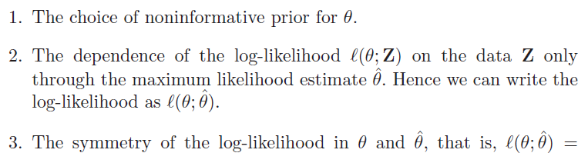

03/ Relationship Between the Bootstrap and Bayesian Inference
a single observation z ,
Prior distribution
as τ → ∞,
same as a parametric bootstrap distribution in which we generate bootstrap values z∗ from
the maximum likelihood estimate of the sampling density N (z, 1)
Notes:
Properties (2) and (3) essentially only hold for the Gaussian distribu-
tion. However, they also hold approximately for the multinomial distribu-
tion, leading to a correspondence between the nonparametric bootstrap
and Bayes inference, which we outline next.

Slide 16





03/ Relationship Between the Bootstrap and Bayesian Inference
Let wj be the probability that a sample point falls in category j
$\hat{\text{wj}}$ the observed proportion in category j ( with L categories )
a prior distribution for w a symmetric Dirichlet distribution with parameter a
the posterior density of w
the bootstrap distributioncan be expressed as sampling the category proportions
from a multinomial distribution.
same mean and nearly the same covariance matrix
Hence, the bootstrap distribution will closely approximate the posterior distribution

Slide 17
THANK YOU

